Slide 1


SGC – session 3
Career Landscape
23rd Jan, 2021

Slide 2
Agenda
Key Roles Overview
Use Cases
Activity
Know Career Tracks
Skills & Competencies needed

Slide 3
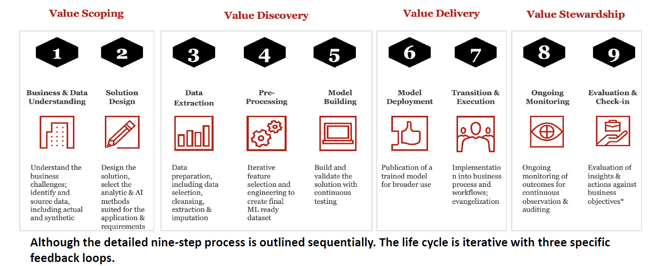
Lifecycle of a Data Science Project
CRISP -DM

Slide 4
Model Lifecycle

Slide 5
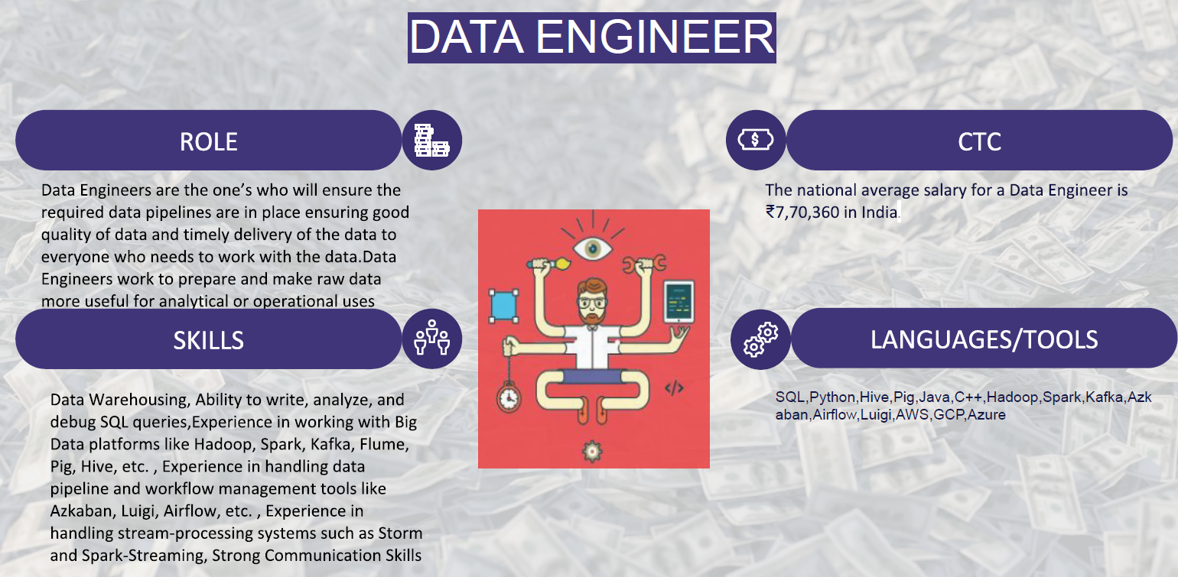
Roles

Slide 6
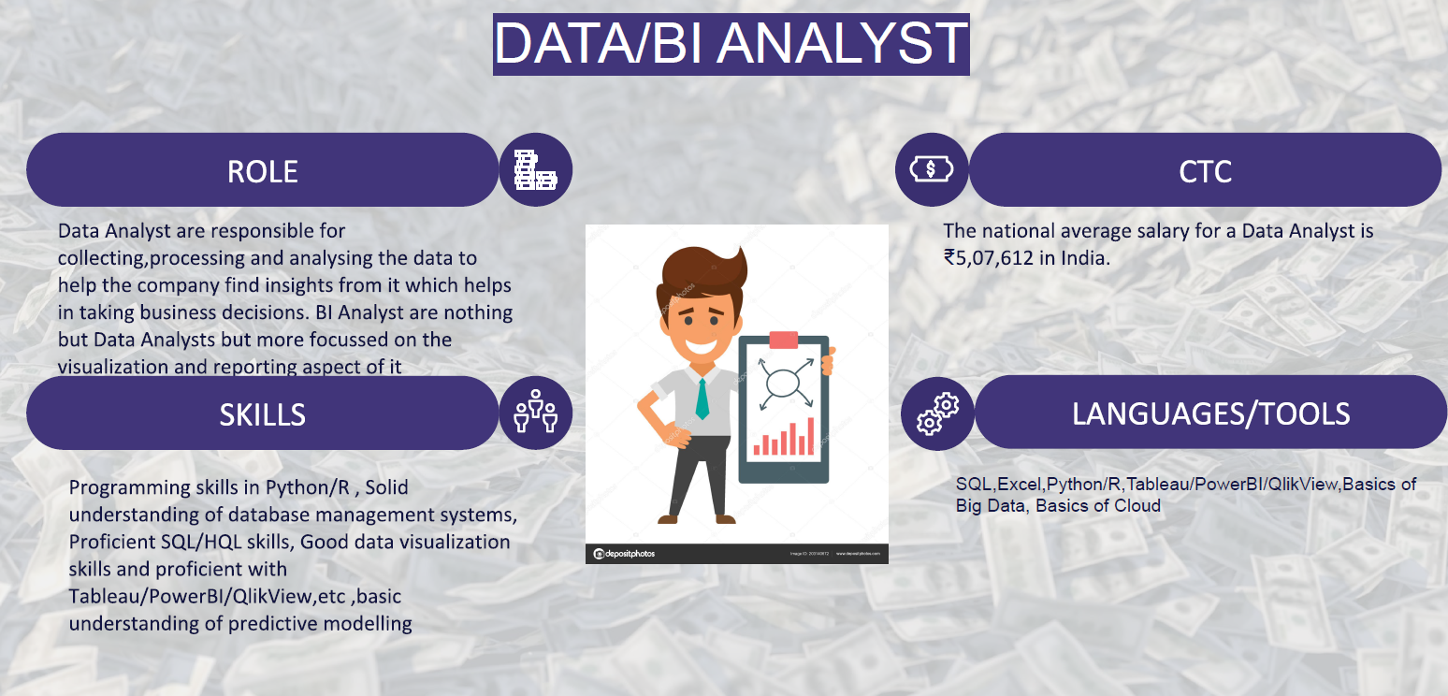
Roles

Slide 7
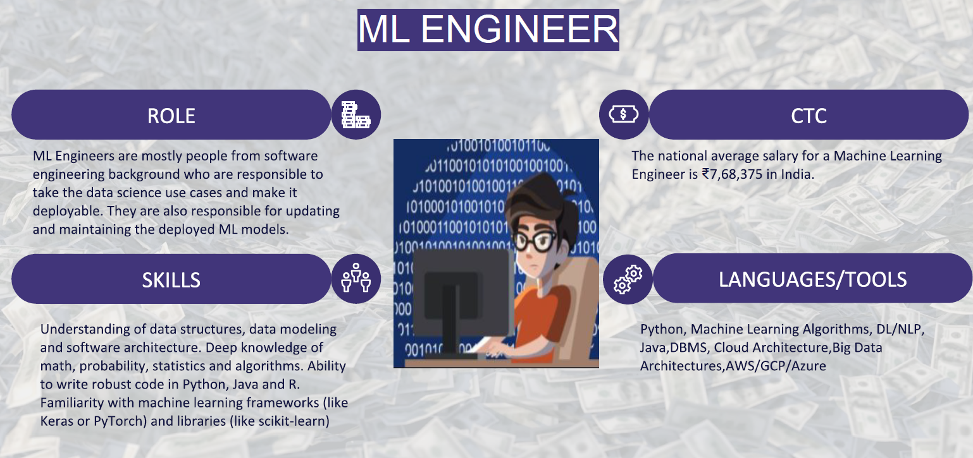
Roles

Slide 8
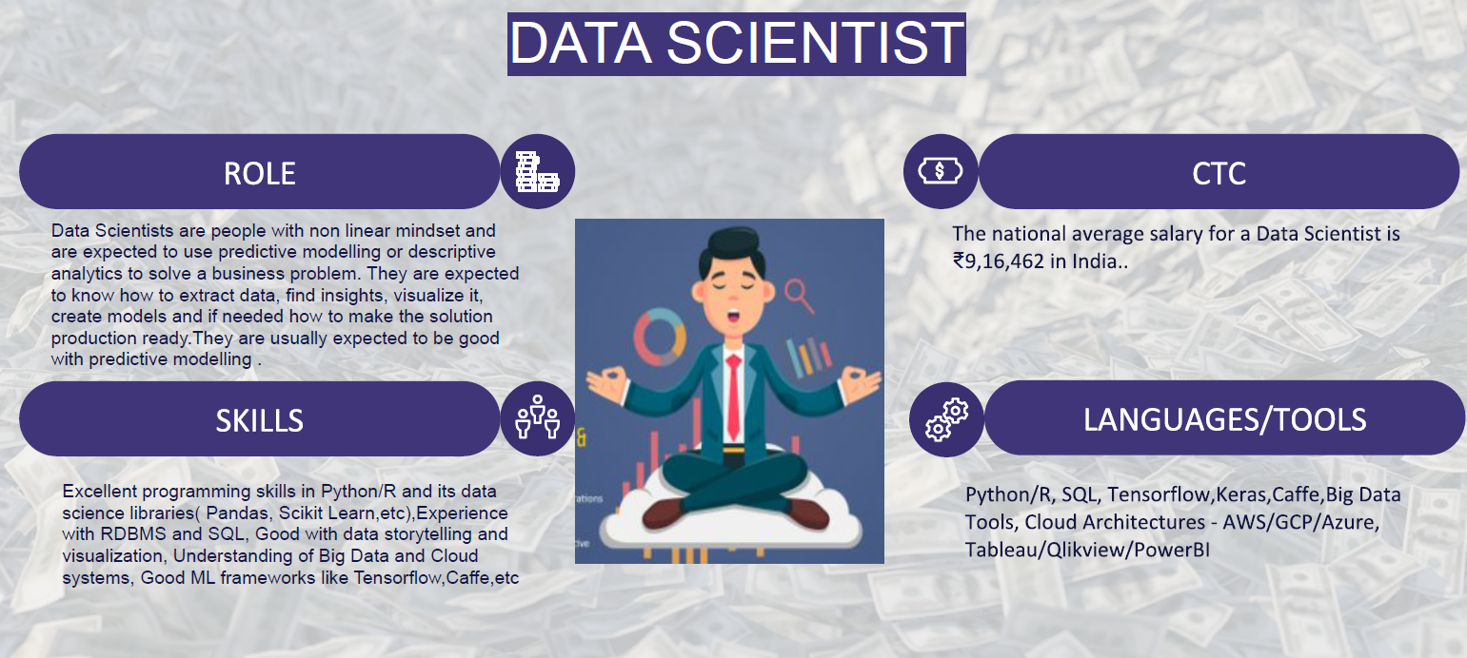
Roles

Slide 9
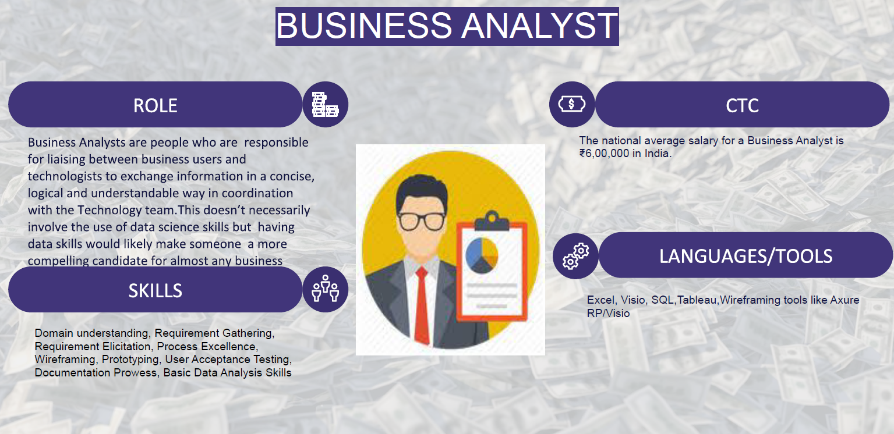
Roles

Slide 10
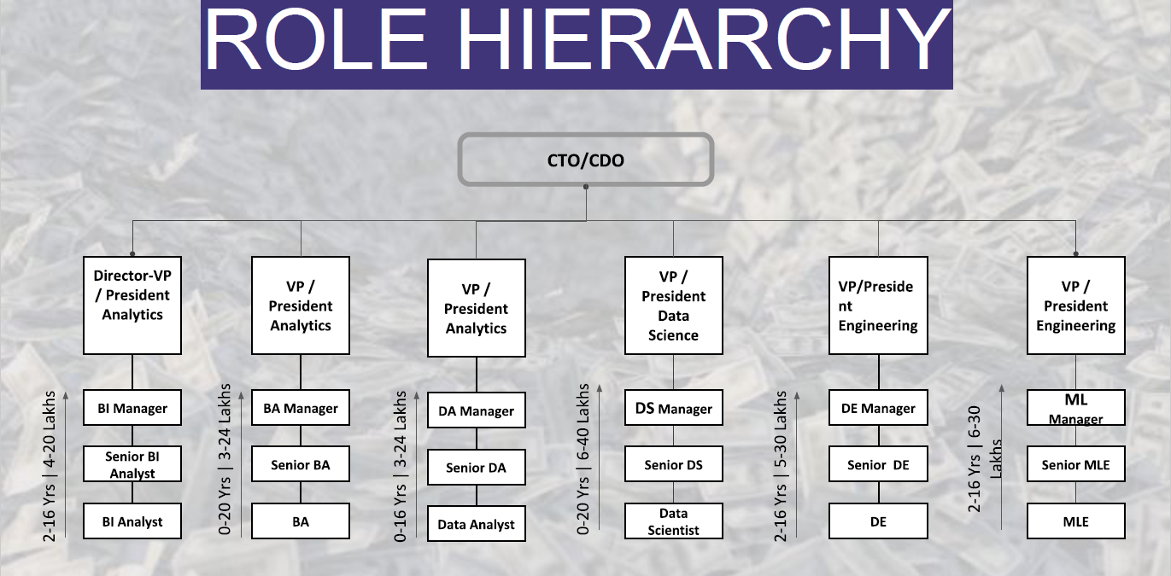
Roles Hierarchy

Slide 11
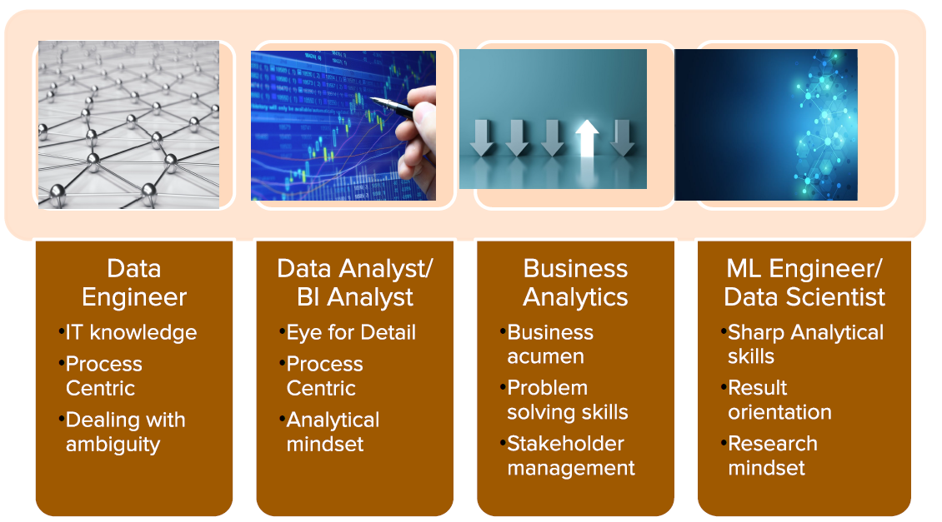
Soft Skills

Slide 12
Use Cases – Banking & Finance
Fraud Detection
Customer Segmentation
Risk Modelling
Personalized Marketing
Lifetime value prediction
Customer Support

Slide 13
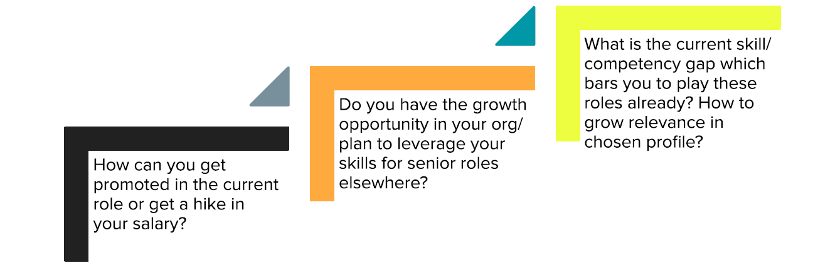
How to grow in current role

Slide 14
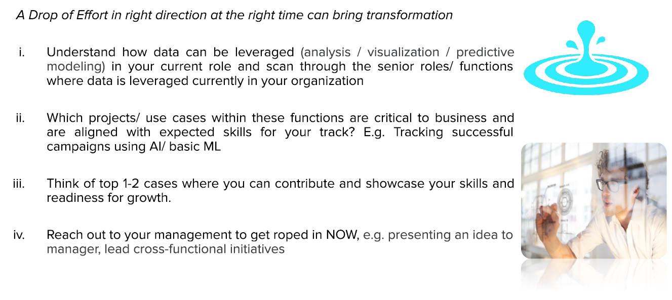
Activity Time

Slide 15


